Slide 1
TECHNOLOGY INTELLIGENCE BRIEFING
The AI Frontier
From predictive models to autonomous agentic intelligence.
Executive Architecture & Market Roadmap

Slide 2



SYSTEM PARADIGM EVOLUTION
Core Architecture Tiers
Predictive ML
Generative AI
Agentic Systems
Pattern recognition from structured data.
Multimodal synthesis via foundation models.
Autonomous reasoning with tool orchestration.

Slide 3
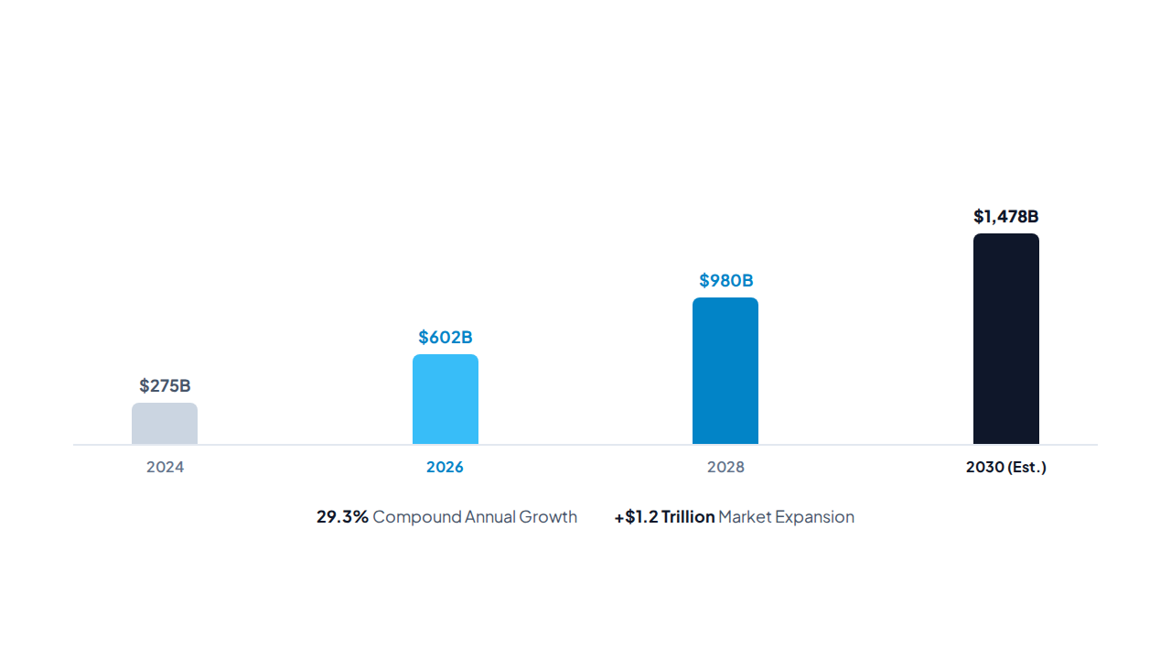
ECONOMIC EXPANSION
Global AI Market Trajectory
Forecast Scale (USD Billions)

Slide 4


OPERATIONAL OUTCOMES
Enterprise Value Drivers
30%
Faster execution cycles across pipelines.
60%
Adoption favoring localized inference architectures.
2.4x
Throughput gains via multi-agent networks.

Slide 5
STRATEGIC HORIZON
Intelligence at Scale
Autonomous systems redefine competitive edge across digital engineering.
Department of Computer Science and Engineering

Slide 6

Image Sources
https://images.stockcake.com/public/5/3/5/53591b03-284f-4b4e-b24b-562ca2350bee_large/neural-network-illuminated-stockcake.jpg
Source: stockcake.com

